Slide 1
Requirement Modeling : Scenario and Class Based Methods
Session 07
Course : Software Engineering
Effective Period : Desember 2017

Slide 2
These slides have been adapted from
Pressman, R.S. (2015). Software Engineering : A Practioner's Approach. 8th ed. McGraw-Hill Companies.Inc, Americas, New York. ISBN : 978 1 259 253157. Chapter 9 and 10
Acknowledgement

Slide 3
LO 2 : Explain the software engineering practices and business environment
Learning Objectives

Slide 4
Contents
Requirements Analysis
Scenario-Based Modeling
UML Models That Suplement the Use Case
Identifying Analysis Classes
Specifying Attributes
Defining Operations
Class-Responsibility-Collaborator Modeling
Associations and Defendencies
Analysis Packages

Slide 5
Requirement Analysis
Requirement modeling types :
Scenario-based models of requirements from the point of view of various system “actors”
Class-oriented models that represent object-oriented classes (attributes and operations) and the manner in which classes collaborate to achieve system requirements
Behavioral and patterns-based models that depicts how the software behaves as a consequence of external “events”
Data models that depicts the information domain for the problem
Flow-oriented models that represent the functional elements of the system and how they transform data as they move through the system

Slide 6
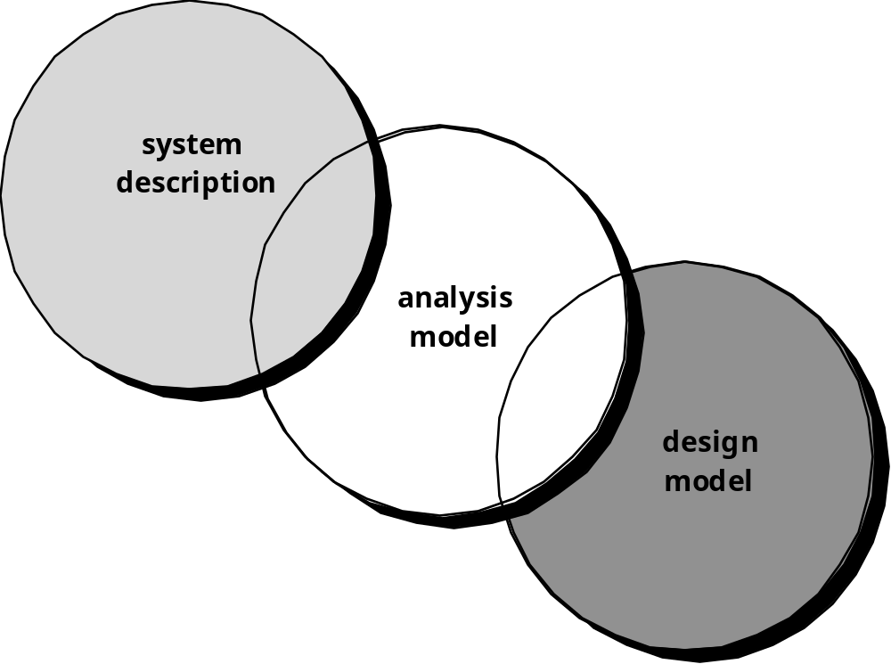
Requirement Analysis
The requirements model as a bridge between the system description and the design model

Slide 7
Requirements Analysis
Rules of Thumb
The model should focus on requirements that are visible within the problem or business domain. The level of abstraction should be relatively high.
Each element of the analysis model should add to an overall understanding of software requirements and provide insight into the information domain, function and behavior of the system.
Delay consideration of infrastructure and other non-functional models until design.
Minimize coupling throughout the system.
Be certain that the analysis model provides value to all stakeholders.
Keep the model as simple as it can be.

Slide 8
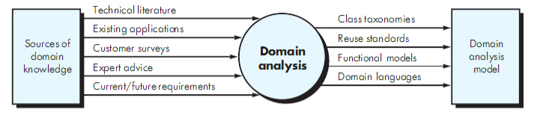
Requirements Analysis
Input and output for domain analysis

Slide 9
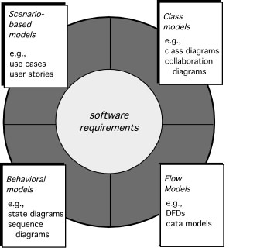
Requirement Analysis
Elements of the analysis model

Slide 10
Scenario-Based Modeling
“[Use-cases] are simply an aid to defining what exists outside the system (actors) and what should be performed by the system (use-cases).” Ivar Jacobson
  (1) What should we write about?
  (2) How much should we write about it?
  (3) How detailed should we make our description?
  (4) How should we organize the description?

Slide 11
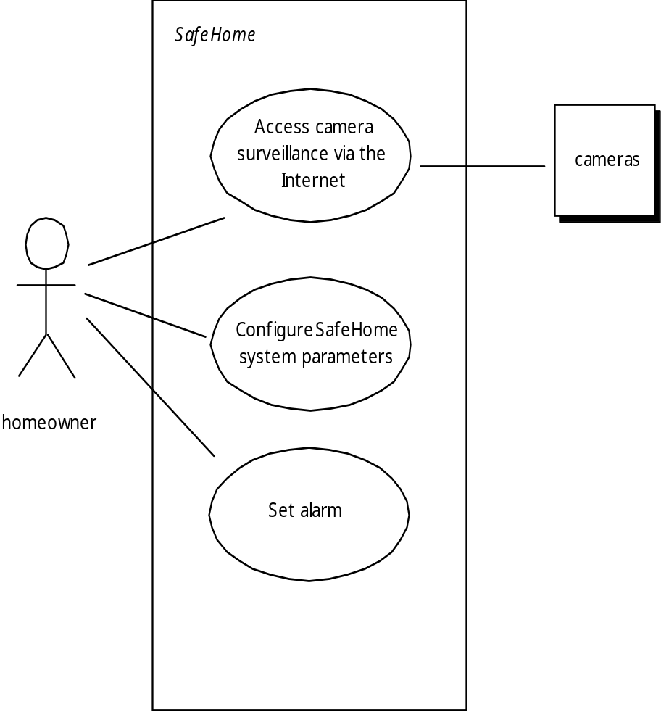
Preliminary use case diagram for the SafeHome system
UML Models That
Suplement the Use Case
a scenario that describes a “thread of usage” for a system
actors represent roles people or devices play as the system functions
users can play a number of different roles for a given scenario

Slide 12
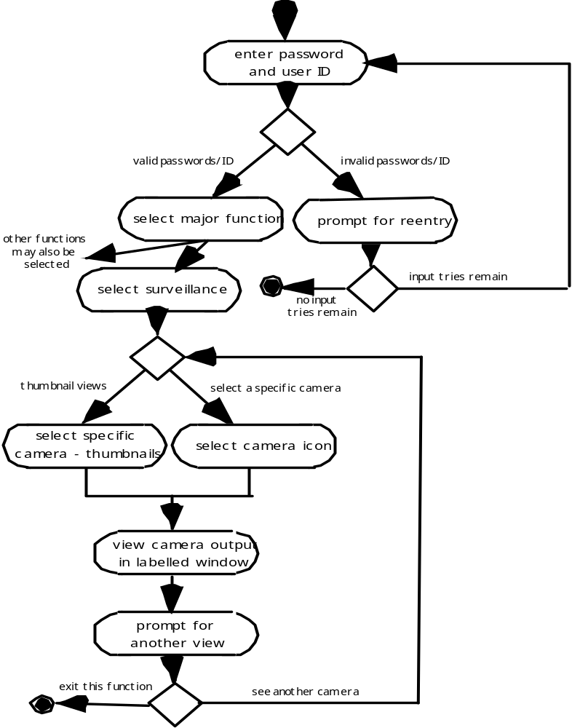
Activity diagram for Access camera survelliance via the Internet- display camera views function
UML Models That
Suplement the Use Case
Supplements the use case by providing a graphical representation of the flow of interaction within a specific scenario

Slide 13
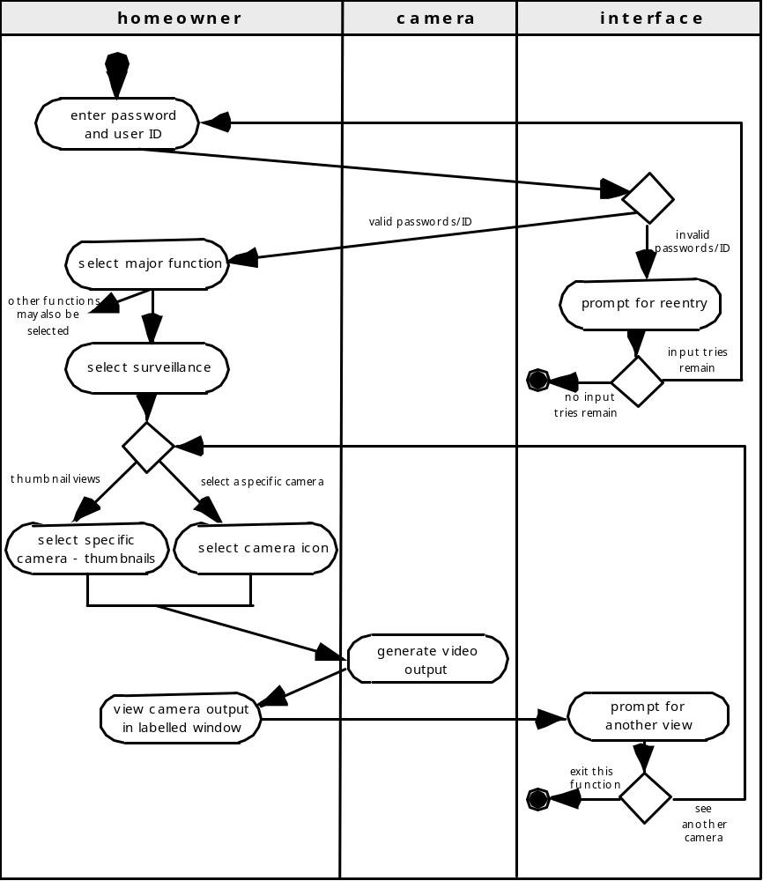
Activity diagram for Access camera survelliance via the Internet- display camera views function
UML Models That
Suplement the Use Case
Allows the modeler to represent the flow of activities described by the use-case and at the same time indicate which actor (if there are multiple actors involved in a specific use-case) or analysis class has responsibility for the action described by an activity rectangle

Slide 14
Identifying Analysis Classes
Class-based modeling represents:
  objects that the system will manipulate
  operations (also called methods or services) that will be applied to the objects to effect the manipulation
  relationships (some hierarchical) between the objects
  collaborations that occur between the classes that are defined.
The elements of a class-based model include classes and objects, attributes, operations, CRC models, collaboration diagrams and packages.

Slide 15
Identifying Analysis Classes
Examining the usage scenarios developed as part of the requirements model and perform a "grammatical parse" [Abb83]
  Classes are determined by underlining each noun or noun phrase and entering it into a simple table.
  Synonyms should be noted.
  If the class (noun) is required to implement a solution, then it is part of the solution space; otherwise, if a class is necessary only to describe a solution, it is part of the problem space.
But what should we look for once all of the nouns have been isolated?

Slide 16
Identifying Analysis Classes
Manifestations of Analysis Classes
Analysis classes manifest themselves in one of the following ways:
External entities: (e.g., other systems, devices, people) that produce or consume information
Things: (e.g, reports, displays, letters, signals) that are part of the information domain for the problem
Occurrences or events: (e.g., a property transfer or the completion of a series of robot movements) that occur within the context of system operation
Roles: (e.g., manager, engineer, salesperson) played by people who interact with the system
Organizational units: (e.g., division, group, team) that are relevant to an application
Places: (e.g., manufacturing floor or loading dock) that establish the context of the problem and the overall function
Structures: (e.g., sensors, four-wheeled vehicles, or computers) that define a class of objects or related classes of objects

Slide 17
Specifying Attibutes
Attributes describe a class that has been selected for inclusion in the analysis model.
  build two different classes for professional baseball players
    For Playing Statistics software: name, position, batting average, fielding percentage, years played, and games played might be relevant
    For Pension Fund software: average salary, credit toward full vesting, pension plan options chosen, mailing address, and the like.

Slide 18
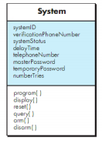
Specifying Attibutes
Class diagram for the system class

Slide 19
Defining Operation
Do a grammatical parse of a processing narrative and look at the verbs
Operations can be divided into four broad categories:
  (1) operations that manipulate data in some way (e.g., adding, deleting, reformatting, selecting)
  (2) operations that perform a computation
  (3) operations that inquire about the state of an object, and
  (4) operations that monitor an object for the occurrence of a controlling event.

Slide 20
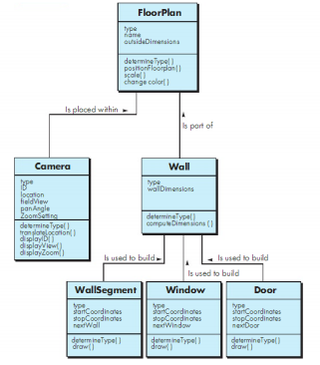
Defining Operation
Class diagram for FloorPlan

Slide 21
Class-Responsibility-Collaborator Modeling
Class-responsibility-collaborator (CRC) modeling [Wir90] provides a simple means for identifying and organizing the classes that are relevant to system or product requirements. Ambler [Amb95] describes CRC modeling in the following way:
  A CRC model is really a collection of standard index cards that represent classes. The cards are divided into three sections. Along the top of the card you write the name of the class. In the body of the card you list the class responsibilities on the left and the collaborators on the right.

Slide 22
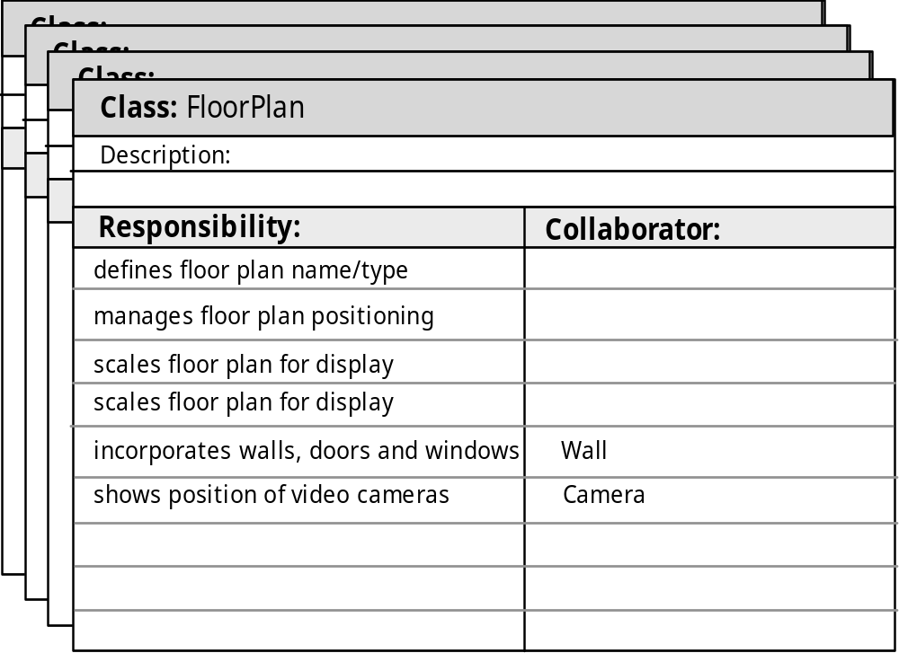
A CRC model index card
Class-Responsibility-Collaborator Modeling

Slide 23

A Composite Aggregate Class
Class-Responsibility-Collaborator Modeling

Slide 24
Associations and Dependencies
Two analysis classes are often related to one another in some fashion
  In UML these relationships are called associations
  Associations can be refined by indicating multiplicity (the term cardinality is used in data modeling
In many instances, a client-server relationship exists between two analysis classes.
  In such cases, a client-class depends on the server-class in some way and a dependency relationship is established

Slide 25
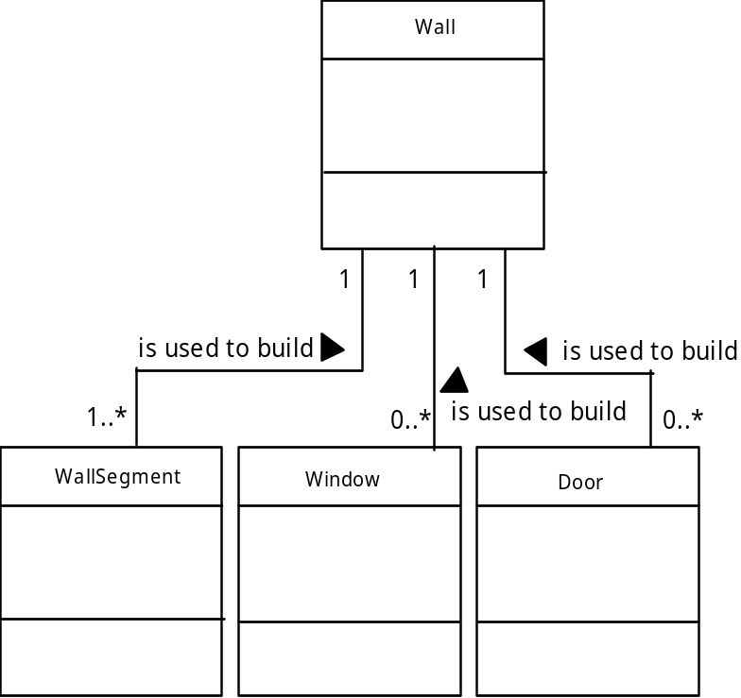
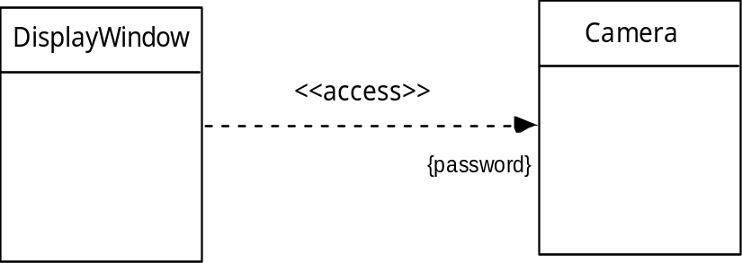
Multiplicity
Associations and Dependencies
Dependencies

Slide 26
Analysis Packages
Various elements of the analysis model (e.g., use-cases, analysis classes) are categorized in a manner that packages them as a grouping
The plus sign preceding the analysis class name in each package indicates that the classes have public visibility and are therefore accessible from other packages.
Other symbols can precede an element within a package. A minus sign indicates that an element is hidden from all other packages and a # symbol indicates that an element is accessible only to packages contained within a given package.

Slide 27
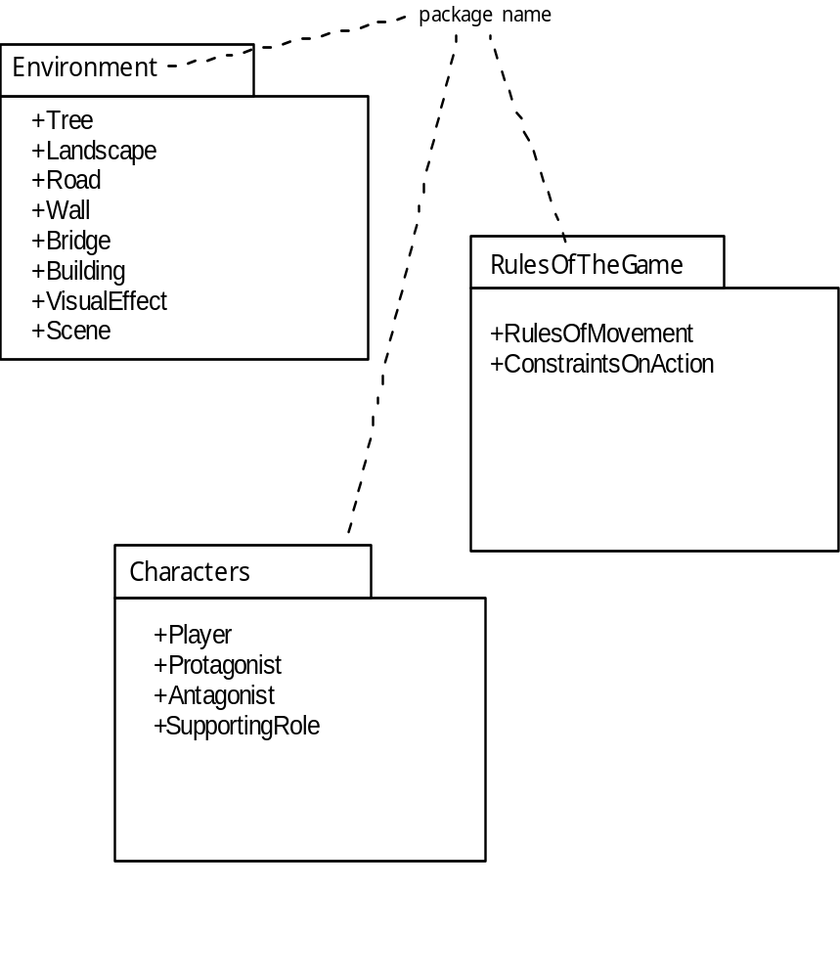
Packages
Analysis Packages

Slide 28
References
Pressman, R.S. (2015). Software Engineering : A Practioner's Approach. 8th ed. McGraw-Hill Companies.Inc, Americas, New York. ISBN : 978 1 259 253157
Modeling and Composing Scenario-Based Requirements with Aspects, https://ti.arc.nasa.gov/m/pub-archive/827h/0827%20(Araujo).pdf
Lecture 10 : Requirements Modeling : Class Based Methods, https://quizlet.com/131399466/lecture-10-requirements-modeling-class-based-methods-flash-cards/

Slide 29
Q & A

